Slide 1
Group Discussion
Rules, Norms, Roles, & Goals

Slide 2
Group Discussion Rules
Come prepared and willing to discuss material.
You cannot sit in the same chair more than once a day. By the end of the semester, you should have been in a group with everyone.
Follow the “norms” of group discussion.
Play your assigned role for the day.

Slide 3
Group Discussion Norms
Prepare by thoughtfully reading ahead of time.
While reading, write notes to yourself listing terms/concepts that you want to discuss.
If you don’t understand something, ask! It is likely that others are confused too.
Don’t keep cool ideas to yourself or your single group.
Use personal experiences to make your points.
Pay attention to what others say: Everyone in a discussion is a teacher!
Be kind and respectful of others in your group.
Explore, rather than avoid, points of disagreement.
Join the discussion – this method of learning only works if you participate.
Encourage your group members!

Slide 4
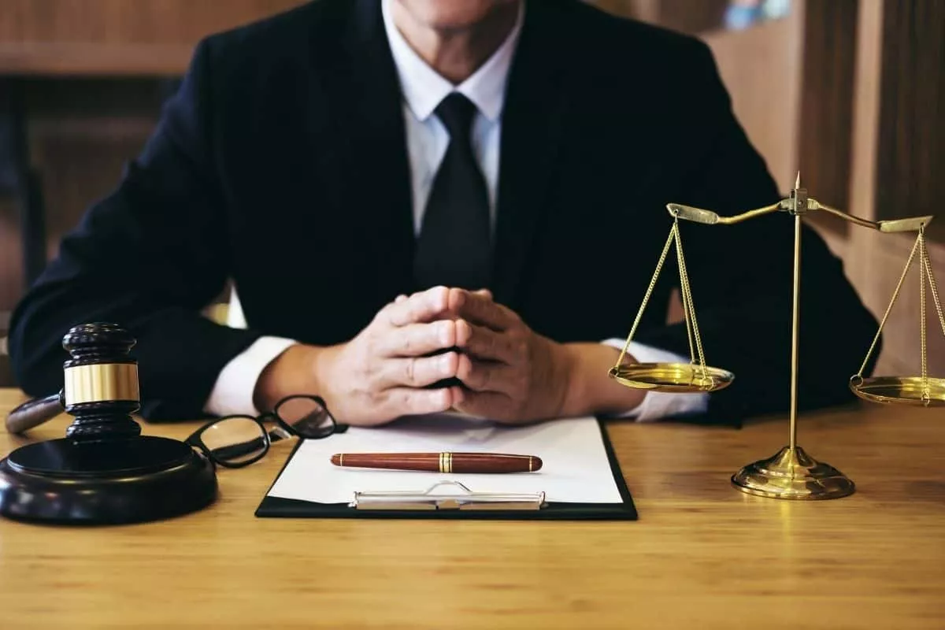
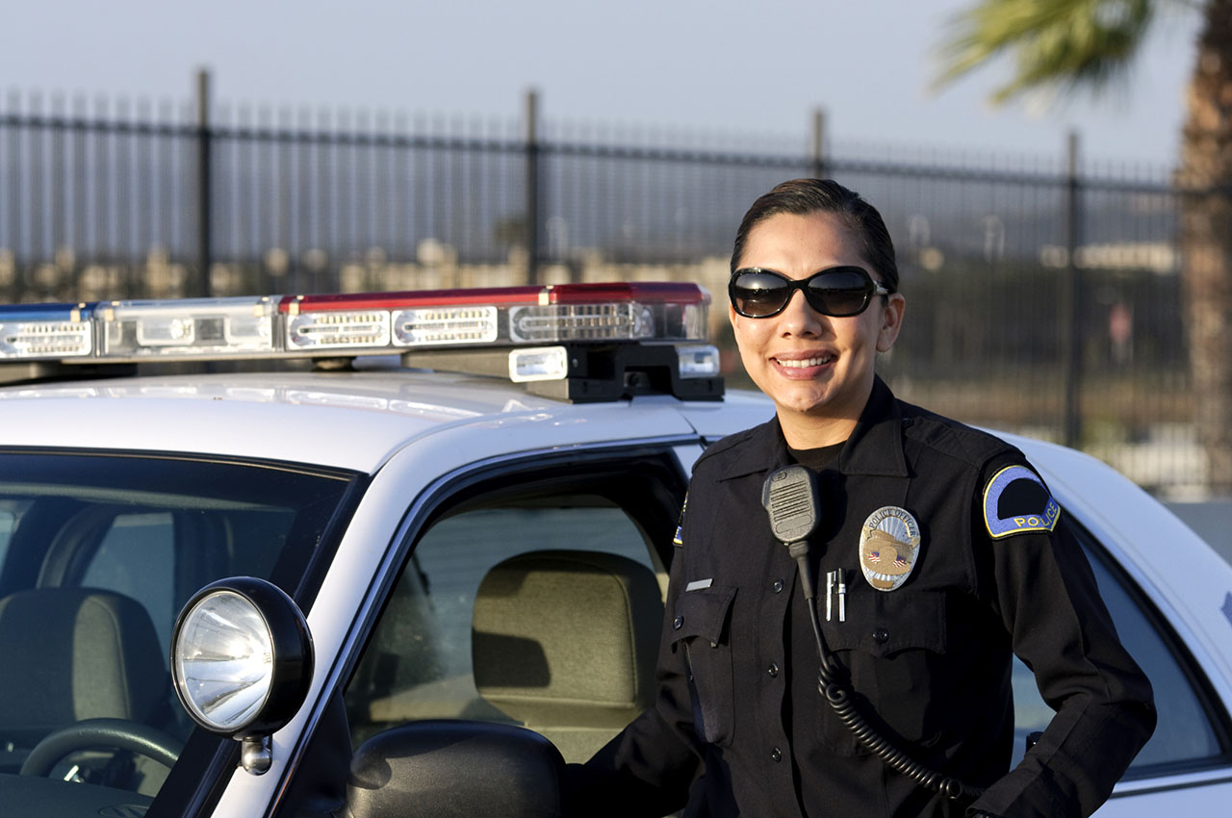
Group Discussion Roles
The Researcher
The Eyewitness
The Defense Attorney
The Police Officer
The Suspect
The Timekeeper
Notes:
If you have fewer than 6 people in your group, you can have one or two people play multiple roles.
Researcher: Pretend you are one of the authors of an assigned reading. Why makes this research cool? Why should we care about it?
Eyewitness: Pretend that you are an eyewitness to a crime. Describe how the concepts described in the readings apply to your experiences.
Defense Attorney: Pretend that you are a DA representing a person that you believe was wrongfully identified by an eyewitness. How might you use the readings to argue for your client’s innocence in court?
Police Officer: Pretend that you are an officer who is interviewing an eyewitness to a crime. How might the readings help you to interact with the eyewitness and obtain an accurate identification?
Suspect: Pretend that you are an innocent suspect who has been misidentified by an eyewitness. How might the readings help you to form an argument for appeal (or, if convicted, apply for exoneration)?
Timekeeper: The timekeeper’s job is to (1) keep the group on task and (2) make sure that everyone gets an equal share in the discussion.

Slide 5
Group Discussion Phases
Phase One:
In Weeks 2-5, self-assign to a role that you are interested in or can relate to. For example, if you plan to pursue law enforcement or have family in law enforcement, join the Police Officer group.
Phase Two:
In Weeks 6-9, you will move to different groups but keep your Phase One role. Make sure to share your unique perspective!
Phase Three:
For the remainder of the semester, you will take on a different role from the one you chose in Phase One. The goal for this phase is to help you consider the issues in this course from different points of view.

Slide 6
Group Discussion Instructions
What did you find interesting/useful?
What was confusing/hard to understand?
What is your group’s unique perspective on the article?
e.g., What should a police officer take away from the readings?
As a group, write one exam question about a reading. This question must be multiple choice.
Make sure that you include good “fillers” in your question!
NOTETAKERS: Write down group’s exam question and email it to me by Friday at 11:59 pm.
Notes:
Why multiple choice? Because a good multiple-choice question is like a good lineup – there is only one correct answer, but the other answers are plausible and a person who did not study/take this class should not be able to guess the correct answer!

